Slide 1
Drawing and Interpreting Conclusions
DSS: GM Lecture 10

Slide 2
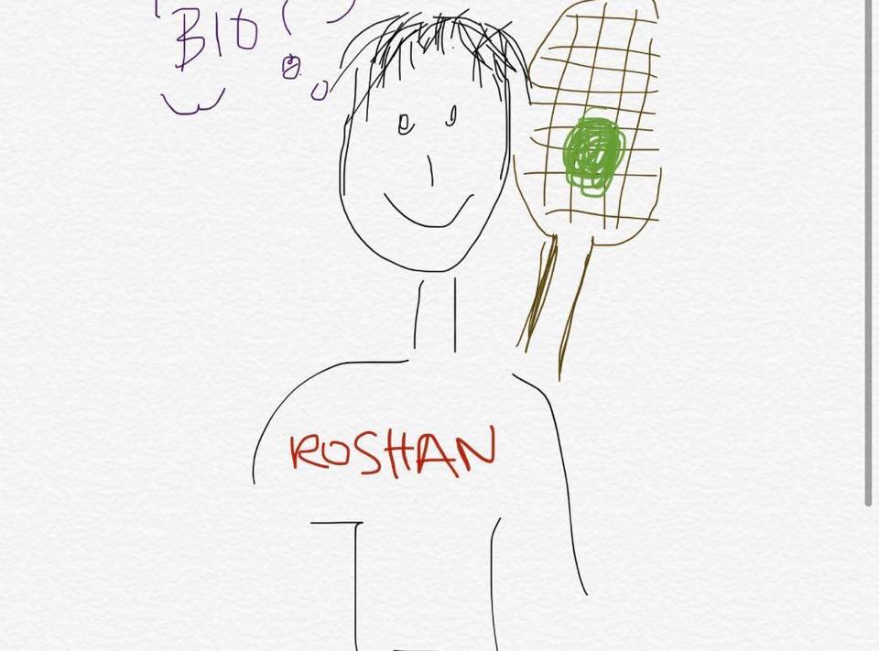


Roshan Lodha
Alleanna Clark
Biochemistry & Molecular Biology, Computer Science
Data Science, Human and Population Health
Picture

Slide 3
Outline
The Data Science Cycle
Problems With Generalizing Results
Drawing Conclusions From Statistical Tests
P-values and Statistical Significance*
Confidence Intervals*
Accuracy, Precision, and Recall*
Handling Continuous Outcomes
Review of Covered Topics
*we will be assuming basic familiarity with these concepts. If you need a refresher, review past lectures or attend the Level 1 lecture.

Slide 4
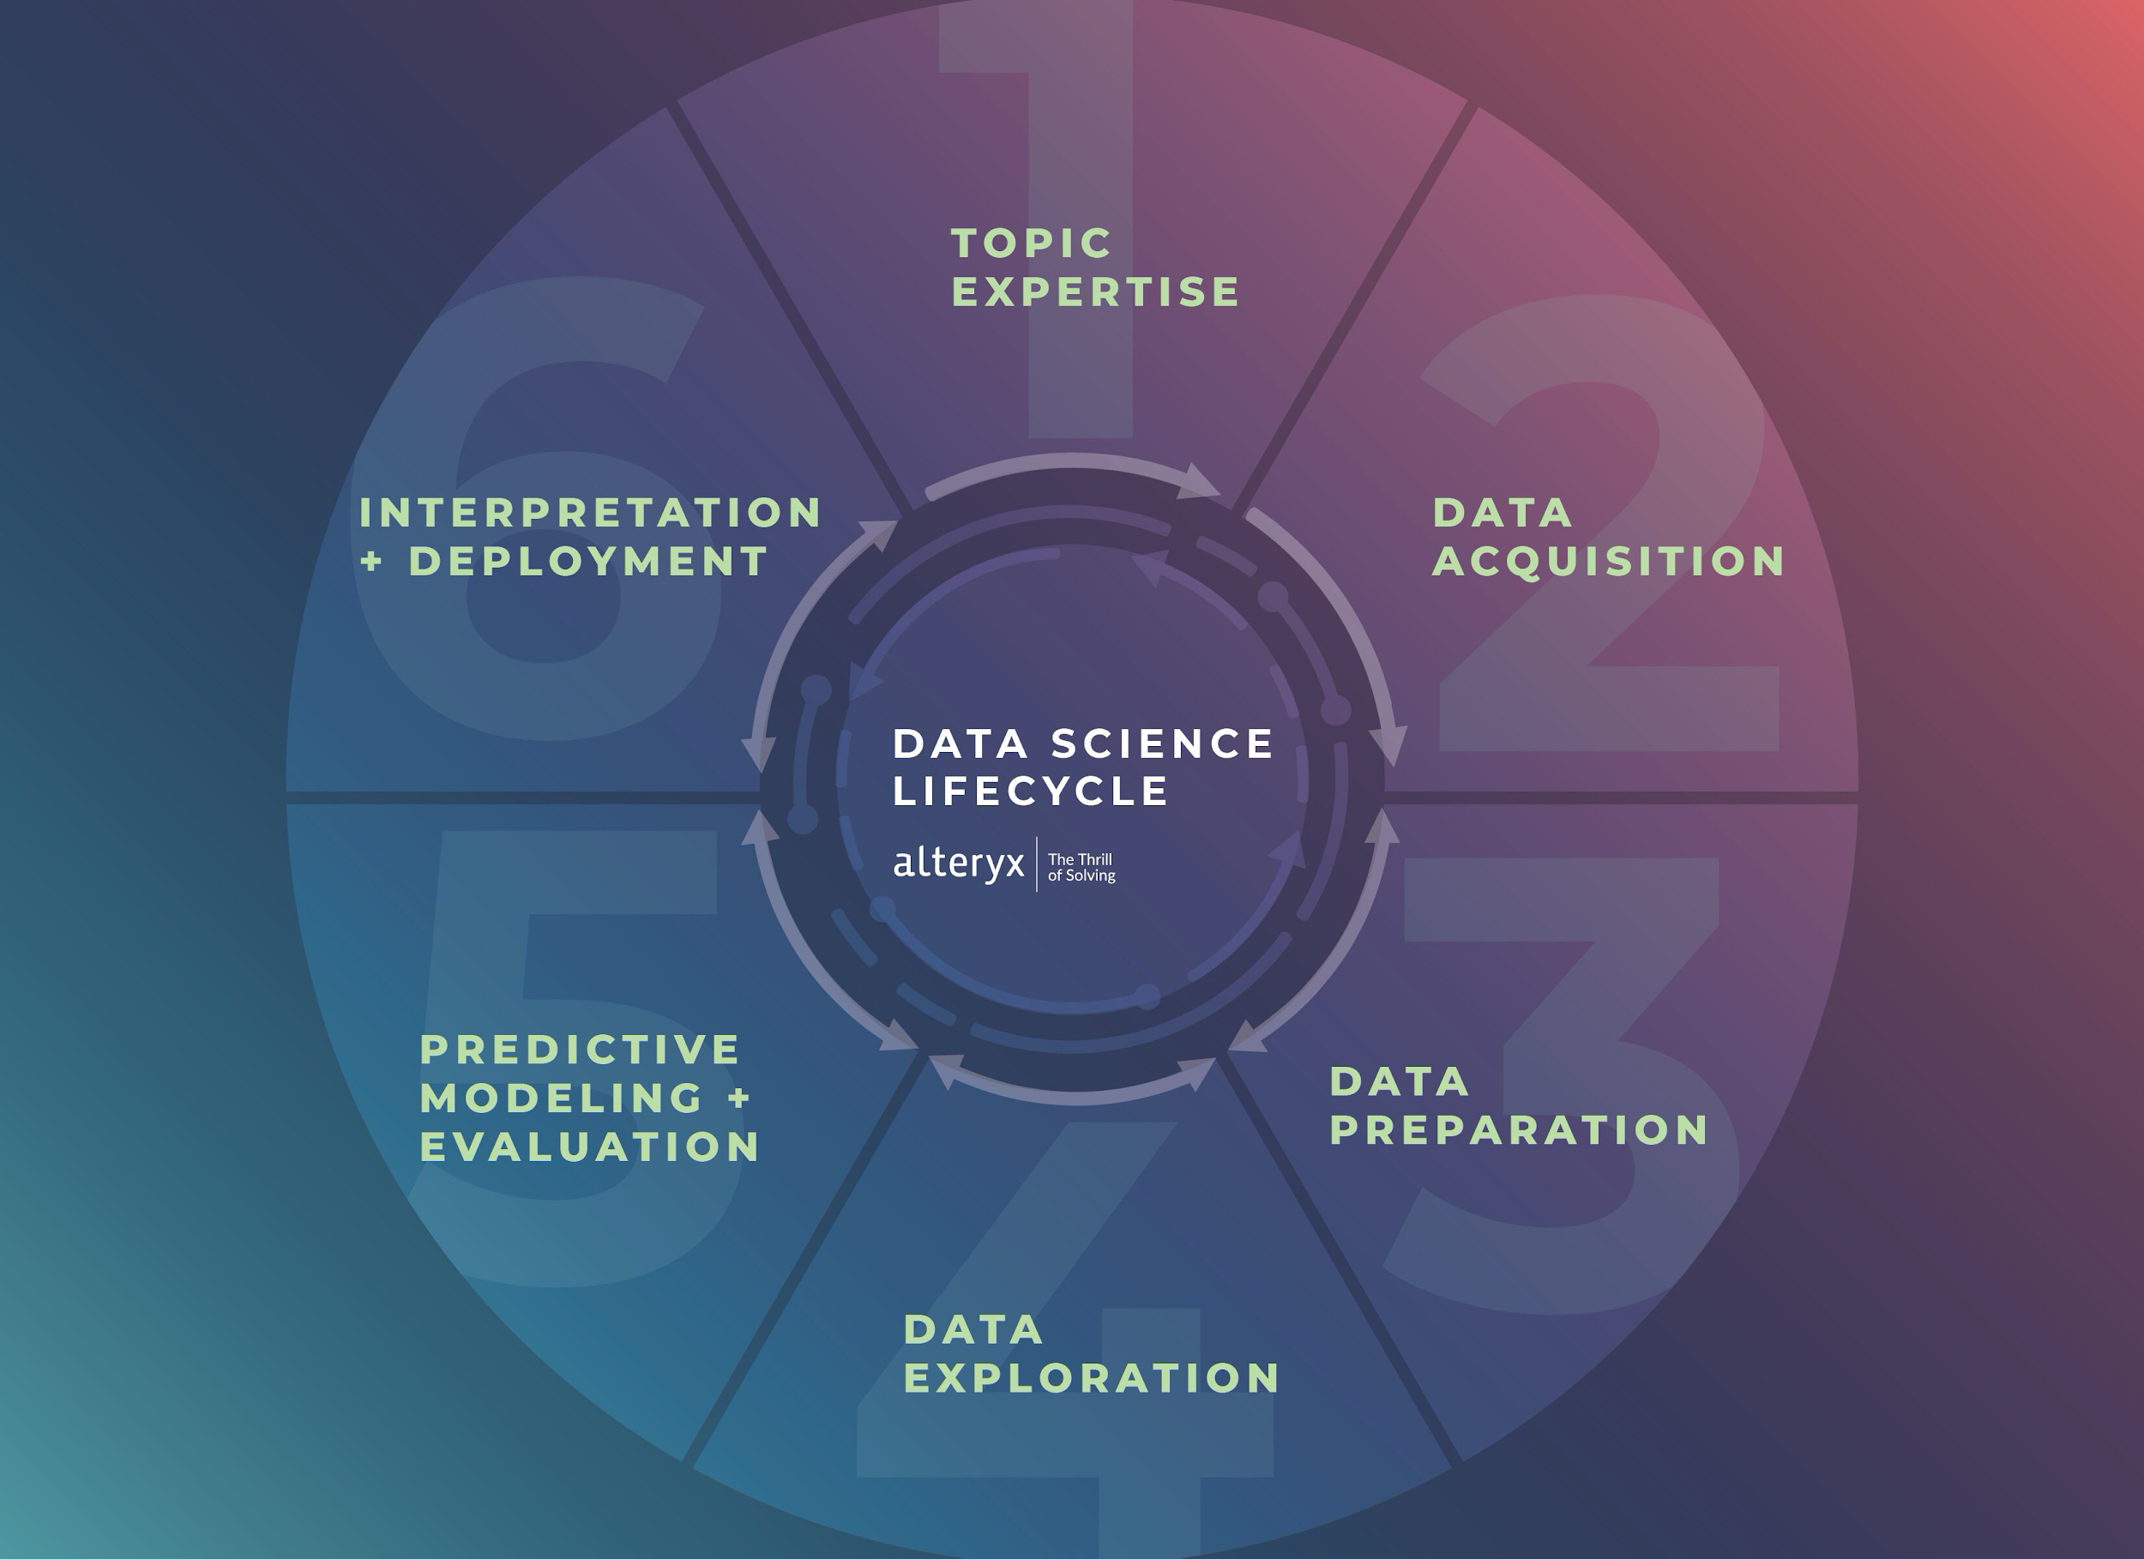
Research Cycle
Define the Problem
Background Research
Constructing a Hypothesis
Conducting an Experiment
Analyze Data and Draw Conclusions
Communicate Results

Slide 5

Issues of Indirectness and Applicability
More often than not, datasets and human modeling are biased. It is important to ask how our biases affect our results, and subsequently how these biases affect the impact of our research.

Slide 6
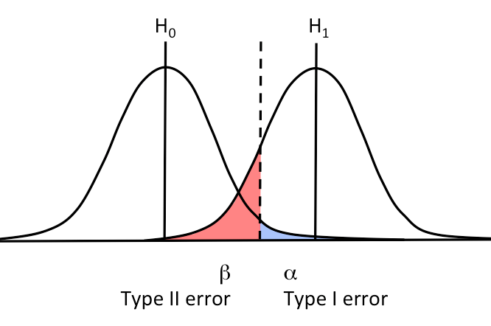
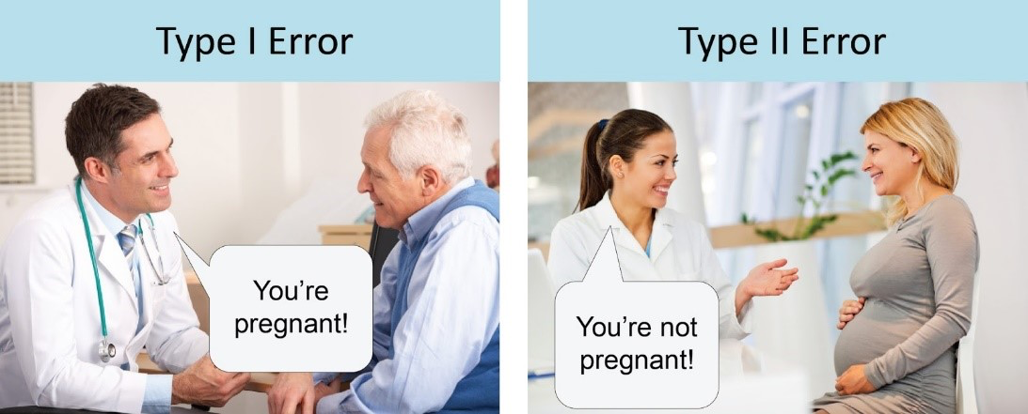
Interpreting Results of Statistical Analysis
a. P-values and Statistical Significance
Changing the cutoff threshold changes the false positive and false negative rates.
False Positives & False Negatives:

Slide 7
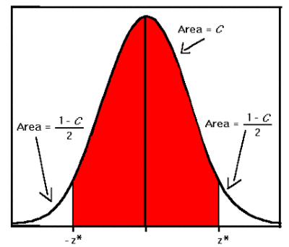
Interpreting Results of Statistical Analysis
b. Confidence Intervals
Confidence interval say what happens in expectation if the experiment is repeated many many times.
They do not say “that I am a certain percent confident the true mean is within this range.”

Slide 8



Interpreting Results of Statistical Analysis
c. Accuracy, Precision, and Recall
Classification Threshold: percent significant chosen to classify something as a hit.
Accuracy:
Precision:
Recall:

Slide 9
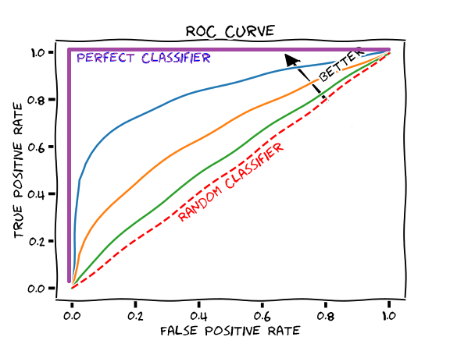
Interpreting Results of Statistical Analysis
c. Accuracy, Precision, and Recall (ROC curves)
The area under a receiver operating characteristic (ROC) curve can be used to evaluate classification models.
They chart the false positive and true negative rate as the threshold of classification changes.

Slide 10
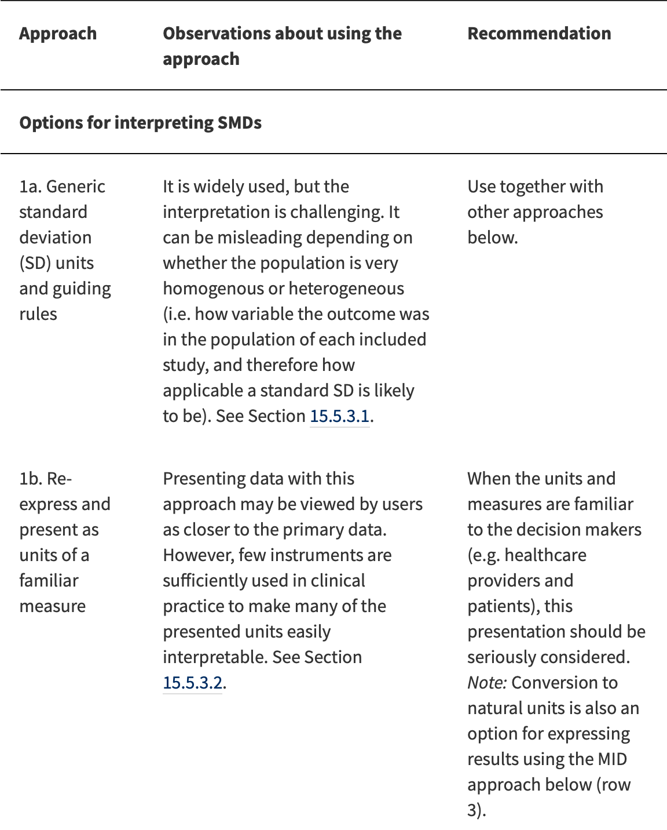
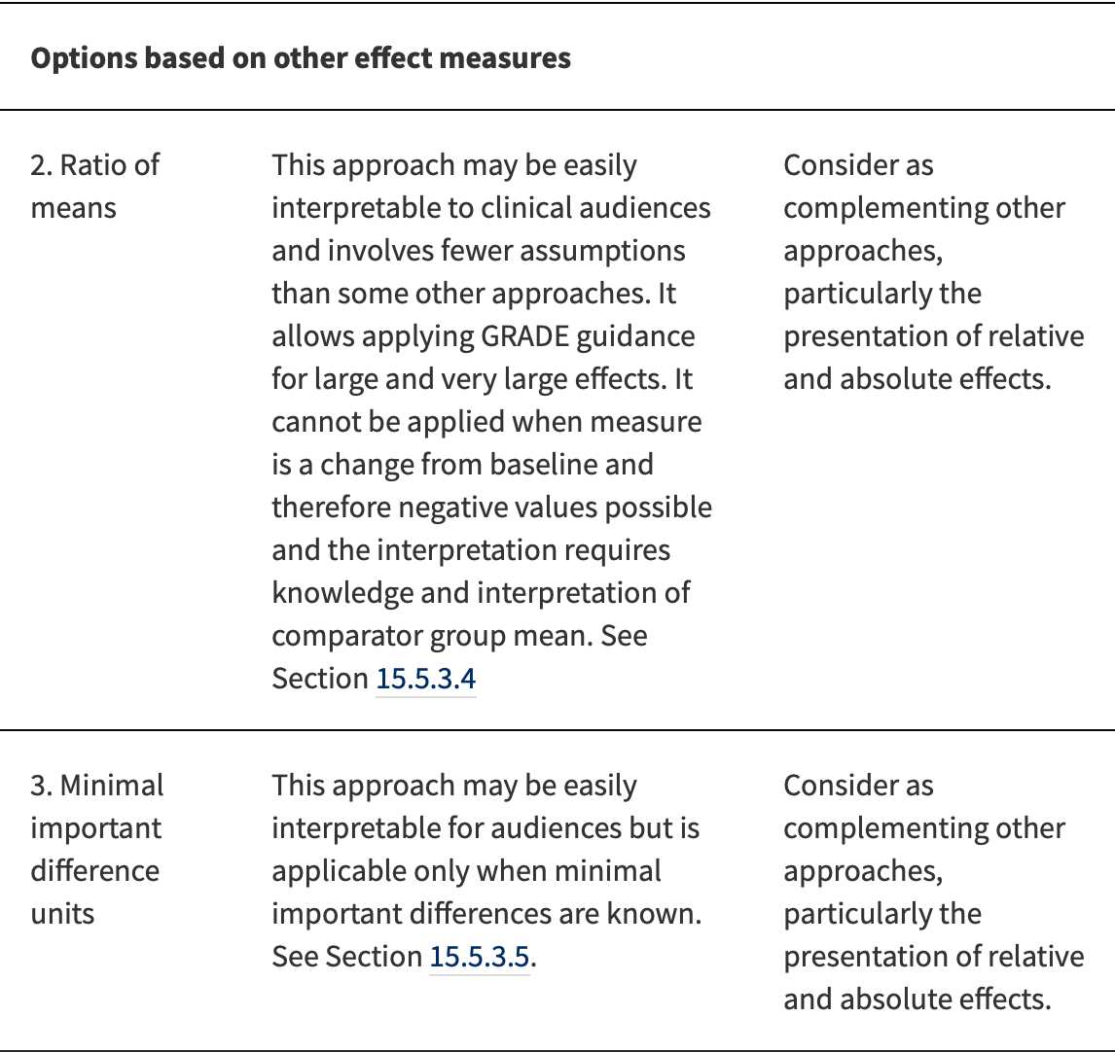
II. Interpreting Results From Continuous Outcomes

Slide 11
Recap of Semester Topics
Data Cleaning - pandas, numpy
Hypothesis Testing - A/B Testing
Visualizations - matplotlib, seaborn, tableau
Machine Learning - sklearn, linear/logistic regression, decision trees
Evaluating a model - accuracy vs. precision, r-squared, cross validation
Resources: https://dss.berkeley.edu/Internal/AcaDev.html

Slide 12
Thank you!
Feedback: forms.gle/y3TRphsAFiQLsCVp8
Slides:
tinyurl.com/GMlec10
please fill out the feedback form

